Slide 1
“Office Nightmare”
Level 4/5 group 15:
Jake Seaman, Macaulay Mills, Callum Walsh and Connor wilby
Notes:
Just a reminder, Office Nightmare isn’t the official name of our game, I just used it for filler. In order to create this power point.

Slide 2

Logline
The player must endure mundane everyday office tasks and allow their curiosity to take over and reveal the mystery behind the nights events.
Notes:
Logline is still the same as it has been in the past.

Slide 3
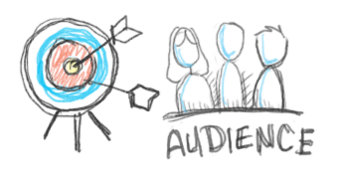
Target Audience
- Gender: Male & Female
- Ages between: 18 – 26
- General interests in:
- Narrative driven video games
- Sorting & matching games
- Point & Click games.
Notes:
Changed the target audience slightly after the results of our plat testing and feed back.

Slide 4






Markets/Platforms
Platforms
- “Office Nightmare” Will be a PC only release supporting…
- Mac
- Linux
- Windows
Markets
- “Office Nightmare” would be sold for £1.99 on sites such as…
- itch.oi
- HumbleBundle.com
- desura.com
Notes:
Just a went into a little bit more detail of our platforms and where we could sell. After doing research into marketing, it would be best to sell it on PC under indie game stores.

Slide 5
Our two emotive words
Liberosis
Monoachopsis
Notes:
Just title cards for our two emotive words.

Slide 6

Liberosis
”The desire to care less about things”
Boring tasks
Greyscale, plain office cubicle
Notes:
Liberiosis slide hasn’t changed.

Slide 7

Monachopsis
”The subtle but persistent feeling of being out of place.”
Seeing things that are out of place
More and more incongruous items appear over the course of the game
Notes:
Monachopsis slide has not changed.

Slide 8

The player experience.
Over all what we want to try and make the player experience.
A sense of lifelessness, confusion, perpetualness, monotony, loneliness and curiosity
And a sense of easy and serious fun
Notes:
The player experience slide has not changed from last power point.

Slide 9

Games mechanics
- 2D Point and Click
Which focuses on a sorting/matching game
- Email Narrative
Email notifications will pop up to show progression in game.
Notes:
Games mechanics are near enough the same, just changed it from 3D to a 2D point & click

Slide 10

Structure and rewards
- The player will complete levels
The player will be rewarded with a hint to the games narrative.
- Using email notifications as the rewarding hint.
Notes:
Structure and rewards are still the same.

Slide 11
Prototype
Notes:
This prototype gif was used with the same software as the previous gif was. It show all our mechanics such as dragging the files into the right folder, dragging the file into the wrong folder and the level progression.

Slide 12
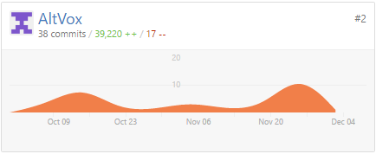
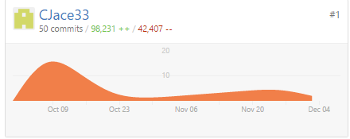
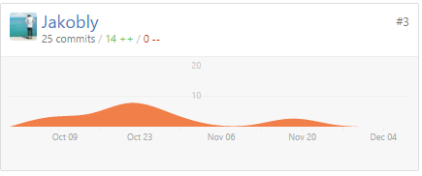
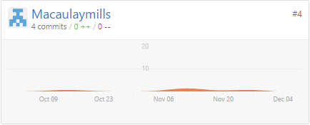
Group information.
Each members total commits to GitHub.
Notes:
This slide covers the commits that each member has made, in no unique order.

Slide 14
What we could have done better
Added challenge to our game
Included more story elements in our game.

Slide 15
What we did well
The game works well and is bug free
There are multiple levels with increasing complexity
The team worked well together to create this game

Slide 16
Thank you for watching
Any questions?

